Slide 1

Enhancing Brain Tumor Diagnosis With Transfer Learning
Review on,
04-04-2025
Guided By:
Ms. Najla Musthafa
Asst. Professor
Computer Science & Engineering
MEA Engineering College
Group Members:
Minhaj Akavalappil (MEA21CS036)
Mohammed Aflah (MEA21CS037)
Mohammed Aseel (MEA21CS038)
Mohammed Jasim A (MEA21CS043)

Slide 2

Outline
Abstract
Introduction
Background Information
Literature Review
Proposed System
Mathematical Expression
Methodology
Algorithm
Publication Title
Application
Result
Conclusion
Future Scope
Paper Publication
References

Slide 3
Abstract
Brain tumors are highly heterogeneous, posing challenges in diagnosis and treatment.
Manual diagnosis using MRI scans is time-consuming and prone to errors.
This project combines EfficientNet-B0 (for classification) and YOLOv8 (for segmentation) into a single AI framework.
EfficientNet-B0 is used to classify brain tumors into 4 categories: glioma, meningioma, pituitary, no tumor.
YOLOv8 performs real-time segmentation, identifying the exact tumor regions in MRI scans.
Transfer learning enhances model performance by using pre-trained weights, reducing training time and improving accuracy on small datasets.

Slide 4
Introduction
Complexity of Brain Tumors:
Tumors like gliomas, meningiomas, and pituitary tumors have different imaging patterns.
Early detection helps in better treatment planning and higher survival rates.
Current Diagnostic Challenges:
Diagnosis relies heavily on radiologists, which can lead to human errors and inconsistent results.
Manual MRI analysis takes a lot of time, delaying critical treatments.
Diagnosis depends on radiologists’ interpretation, which can vary.
Advancements in AI and Deep Learning:
AI-based deep learning models can automate tumor detection with higher accuracy.
These models can process thousands of scans quickly, reducing radiologist workload.

Slide 5
Introduction(cont.)
Significance of Transfer Learning (TL):
Transfer learning uses models already trained on large datasets (like ImageNet).
It improves accuracy on small medical datasets and reduces training time.
EfficientNet for Classification
EfficientNet-B0, a lightweight but powerful CNN, is fine-tuned to classify tumors into four categories.
Its compound scaling (balancing depth, width, resolution) improves efficiency and accuracy.
YOLO for Segmentation
YOLO (You Only Look Once) is widely used for fast object detection, including tumor localization in MRI images.

Slide 6
Background Information
Brain Tumors and Imaging
Brain tumors are abnormal cell growths inside the brain.
MRI scans are commonly used for detection and analysis due to their detailed imaging.
AI and Deep Learning in Medical Imaging
AI models can analyze MRI scans faster and detect subtle patterns.
They offer higher consistency and help in reducing diagnostic errors.
EfficientNet and YOLO - Emerging Tools
EfficientNet offers high accuracy in image classification with optimized size and speed.
YOLO (You Only Look Once) is widely used for fast object detection, including tumor localization in MRI images.

Slide 7
Literature Review
Sl No. | Paper | Description | Merits | Demerits
1 | A. Kadam, S. Bhuvaji, and S. Deshpande, "Brain Tumor Classification Using Deep Learning Algorithms," IJRASET, vol. 9, Dec. 2021. | Used deep learning models like CNN for classifying brain tumors into different types based on MRI images. | • Effective for basic tumor type classification. • Works well with moderate-sized datasets. | • Limited generalization to rare tumor types. • Relies heavily on data quality.
2 | M. I. Mahmud, M. Mamun, and A. Abdelgawad, "A Deep Analysis of Brain Tumor Detection from MR Images Using Deep Learning Networks," Algorithms, vol. 16, no. 176, 2023. | Compared multiple deep learning architectures to detect brain tumors in MRI images. | • Comprehensive comparison of models. • Focuses on accuracy and reliability. | • Models require high computational power. • Manual pre-processing is needed.

Slide 8
Literature Review
Sl No. | Paper | Description | Merits | Demerits
3 | S. Solanki, U. P. Singh, S. S. Chouhan, and S. Jain, "Brain Tumor Detection and Classification Using Intelligence Techniques," LNCT University, Bhopal. | Applied a mix of machine learning and deep learning techniques to classify brain tumors. | • Uses hybrid methods for better accuracy. • Works with limited data. | • High complexity in model training. • Needs feature engineering.
4 | Z. Jia and D. Chen, "Brain Tumor Identification and Classification of MRI Images Using Deep Learning Techniques," Harbin University of Science and Technology. | Focused on automating identification and type classification using CNN. | • Automated process reduces human error. • CNN handles image patterns well. | • Not optimized for rare cases. • Performance depends on training size.

Slide 9
Literature Review
Sl No. | Paper | Description | Merits | Demerits
5 | A. B. Abdusalomov, M. Mukhiddinov, and T. K. Whangbo, "Brain Tumor Detection Based on Deep Learning Approaches and Magnetic Resonance Imaging," Cancers, vol. 15, no. 4172, 2023. | Explored deep learning models trained on MRI datasets for tumor detection. | • Works on multi-type tumors. • Suitable for clinical settings. | • Requires fine-tuning for new datasets. • Sensitive to noise in images.
6 | N. Shamshad et al., "Enhancing Brain Tumor Classification by a Comprehensive Study on Transfer Learning Techniques and Model Efficiency Using MRI Datasets," Dalian University of Technology. | Studied different transfer learning models for brain tumor classification using MRI data. | • Reduces training time significantly. • Works with small labeled datasets. | • Needs careful model selection. • Overfitting risk if source and target data mismatch.

Slide 10
Literature Review
Sl No. | Paper | Description | Merits | Demerits
7 | D. L. B. Reddy et al., "Multiclass Brain Tumor Classification Using Transfer Learning," JIEEE, vol. 05, no. 01, 2024. | Used pre-trained models to classify multiple tumor types. | • Good accuracy for multi-class problems. • Efficient for low-resource training. | • Needs high-quality pre-trained models. • Tuning complexity increases with more classes.
8 | R. Redmon and A. Farhadi, "YOLO: Real-Time Object Detection," CVPR, 2018. | Proposed the YOLO object detection framework, applied to medical imaging later. | • Fast detection suitable for real-time use. • Detects object (tumor) location directly. | • Needs large annotated datasets. • Performance drops on very small tumors.

Slide 11
Literature Review
Sl No. | Paper | Description | Merits | Demerits
9 | H. H. Sultan, N. M. Salem, and W. Al-Atabany, "Multi-Classification of Brain Tumor Images Using Deep Neural Networks," IEEE Access, 2019. | Developed deep neural networks for classifying brain tumors into multiple categories. | • Handles multi-class well. • Shows strong classification accuracy. | • Needs large diverse datasets. • Computationally heavy.
10 | K. Simonyan and A. Zisserman, "Very Deep Convolutional Networks for Large-Scale Image Recognition," ICLR, 2015. | Introduced VGG, one of the most popular deep learning architectures. | • Highly transferable features. • Simple architecture. | • High memory requirement. • Slow inference compared to modern models.

Slide 12
Proposed System
Dataset Preparation
Collect 5000 MRI images (4 classes: glioma, meningioma, pituitary, no tumor)
Resize images for classification and segmentation
Apply data augmentation (flip, rotate, zoom) to increase image variety
Classification using EfficientNet-B0
Use EfficientNet-B0 (pre-trained on ImageNet)
Apply transfer learning – retrain the model on brain tumor data
Output: Probability for each of the 4 tumor classes
Segmentation using YOLOv8
Train YOLOv8 to detect and segment tumors in MRI images
YOLO draws a bounding box and mask around the tumor
Final Output
Classified tumor type + segmented tumor region
Helps radiologists for faster and more accurate diagnosis

Slide 13
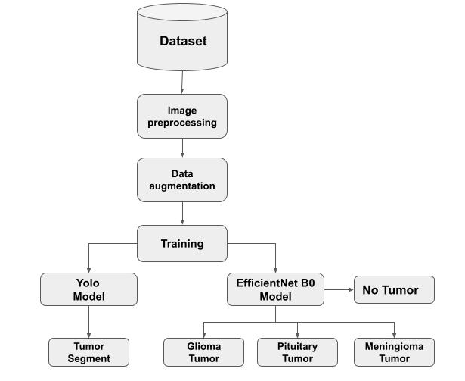
Proposed System

Slide 14
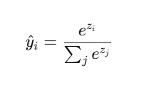

Mathematical Expression
Softmax Equation
The softmax function is used in the final layer of the model to convert raw logits (outputs of the neural network) into probabilities for each class.
Equation:
Where:
Each class probability = (exponentiated value) / (sum of all exponentiated values).
zᵢ = raw score for class i.
Example: If scores for 4 classes are: [2, 1.5, 0.5, -0.5]
This gives probabilities like [0.7, 0.2, 0.08, 0.02].

Slide 15
Mathematical Expression
EfficientNet-B0 with Transfer Learning for Classification
Key Mathematical Expression: Categorical Cross-Entropy Loss
This formula measures how much the predicted class differs from the actual class. It compares the correct label (what the image actually is) with what the model predicted.
Expression:
L = -∑(y_true * log(y_pred))
ytrue​: The correct label (actual class - like glioma, meningioma, etc.)
ypred​: The predicted probability for each class.

Slide 16
Mathematical Expression
YOLOv8 for Segmentation
Key Mathematical Expression: Intersection over Union (IoU)
This formula measures how much the predicted tumor region overlaps with the actual tumor region.
Expression:
IoU = |A ∩ B| / |A ∪ B|
A: The predicted tumor region.
B: The actual tumor region (from the dataset).

Slide 17
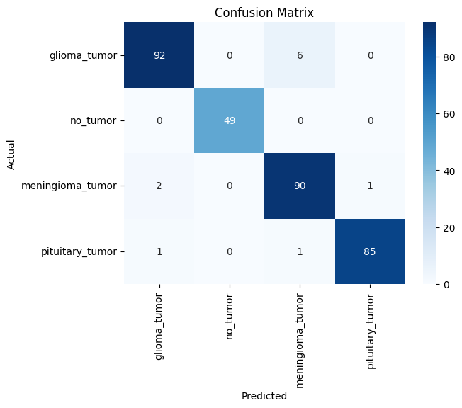
Mathematical Expression

Slide 18
Methodology
1. Dataset Collection: Collect 5000 MRI images across 4 categories — glioma tumor, meningioma tumor, pituitary tumor, and no tumor.
2. Data Preprocessing:
Augmentation: Apply rotation, flipping, zooming for data diversity.
Annotation: Tumor regions manually marked for segmentation.
3. Model Selection:
Use EfficientNet-B0 (pretrained on ImageNet) for classification.
Use YOLOv8 for segmentation (to detect and outline tumor regions).
4. Training:
EfficientNet-B0: Fine-tuned using Transfer Learning for 4-class classification.
YOLOv8: Trained to detect and segment tumors using annotated images.

Slide 19
Methodology
5. Loss Functions:
Classification Loss: Categorical Cross-Entropy:
L = -∑(y_true * log(y_pred))
Segmentation Loss: Intersection over Union (IoU):
IoU = |A ∩ B| / |A ∪ B|
6. Evaluation:
Classification Metrics: Accuracy, Sensitivity, Specificity, F1-score.
Segmentation Metric: IoU (measures overlap between predicted and actual tumor area).
7. Deployment:
Plan to develop a simple application for radiologists to upload MRI scans and get instant tumor detection and classification results.

Slide 20
Algorithm
Step-1: Start
Step-2: Import required libraries for image processing, machine learning, and deep learning.
Step-3: Load the dataset containing 4 categories:
- glioma tumor
- meningioma tumor
- pituitary tumor
- no tumor
Step-4: For each category:
Read all images.
Resize each image to (150,150).
Append image and label to dataset.
End For
Step-5: Shuffle and split data into training and testing sets.
Step-6: Convert labels into categorical format .
Step-7: Build classification model using EfficientNetB0 as base model.

Slide 21
Algorithm
Step-8: Choose categorical cross-entropy as the loss function.
Step-9: Use the Adam optimizer to help the model learn faster and more efficiently.
Step-10:Train the model using a fixed number of epochs .
Step-11: Train the classification model using training data with validation split.
Step-12: Evaluate the model using test data.
Step-13: Generate classification report and confusion matrix.
Step-14: Visualize sample predictions to check accuracy.
Step-15: Download annotated tumor segmentation dataset using Roboflow API.
Step-16: Load YOLOv8 model for segmentation.
Step-17: Train YOLO model using the downloaded dataset.
Step-18: Predict tumor regions in test images using YOLO.
Step-19: Draw segmentation boundaries around detected tumors.
Step-20: End

Slide 22
Publication Title
EfficientNet-Based and YOLO-Driven Brain Tumor Detection and Segmentation

Slide 23
Applications
Medical Diagnosis: Helps radiologists detect and classify brain tumors.
Surgical Planning: Provides accurate tumor segmentation for surgery preparation.
Telemedicine: Enables remote diagnosis in areas without specialists.
Patient Monitoring: Tracks tumor changes during treatment.
Medical Research: Supports research by providing labeled data and analysis.
Health Apps: Can be integrated into mobile apps for initial screening.
Education: Used to train medical students in MRI interpretation and tumor analysis.

Slide 24
Result
Accurate Tumor Classification
EfficientNet-B0 achieves final training accuracy of approximately 99.7%.
Validation accuracy reaches 98.3%, indicating excellent generalization to unseen data.
High F1-score of 96% across all classes confirms balanced performance.
Efficient Segmentation
YOLOv8 segmentation model achieves a mean Average Precision (mAP) of 81.2%.
Tumor regions (glioma, meningioma, pituitary) are accurately highlighted in MRI scans.
Real-time segmentation ensures faster processing.
Robust Training Process
Training shows steadily reducing loss, with final loss around 0.0092, indicating strong model stability and minimal overfitting.

Slide 25
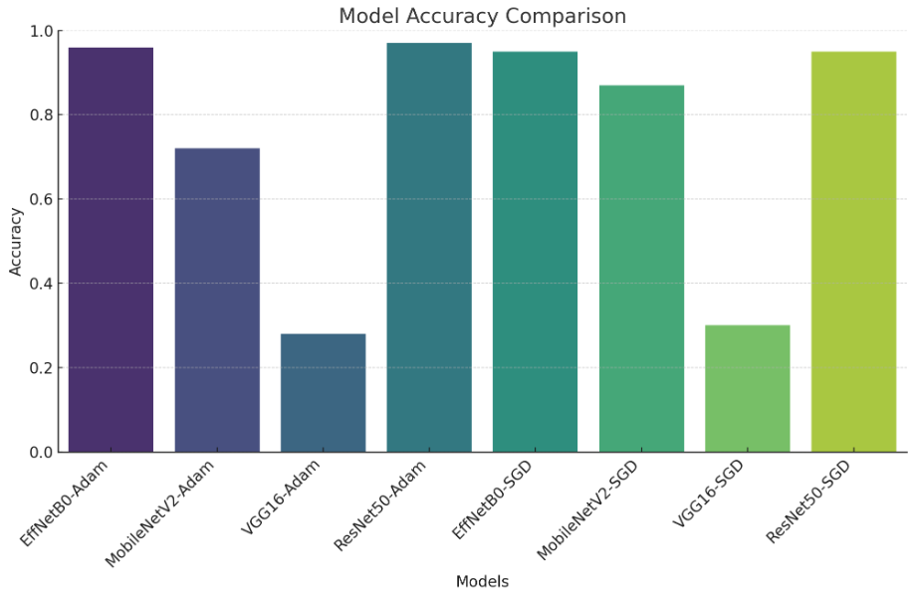
Result
Best Model: EfficientNetB0 with Adam.
Why EfficientNetB0?
Higher accuracy than MobileNetV2, VGG16, and ResNet50.
More efficient with fewer parameters than ResNet50 and VGG16.
Better feature extraction with compound scaling.
Key Takeaway: EfficientNetB0-Adam is the best choice for brain tumor detection, ensuring high accuracy with efficiency.

Slide 26
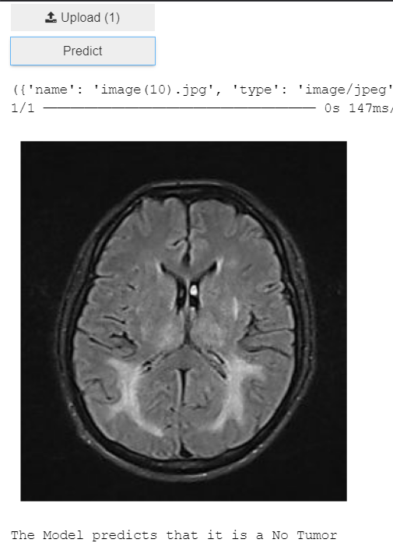
Result
No Tumor

Slide 27
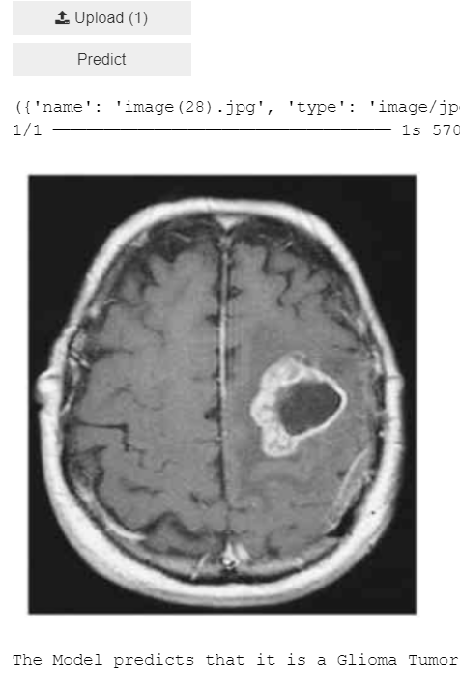
Result
Detection

Slide 28
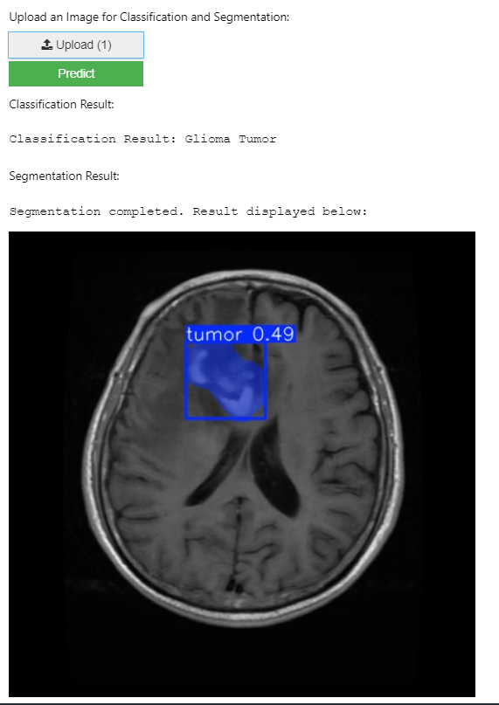
Result
Segmentation

Slide 29
Conclusion
The proposed system effectively classifies brain tumors into four categories (glioma, meningioma, pituitary tumor, no tumor) using EfficientNet-B0.
Tumor segmentation is successfully performed using YOLOv8, enabling precise localization of tumor regions.
Transfer learning helps leverage pre-trained knowledge, improving accuracy and reducing training time.
The system assists radiologists by providing quick and reliable second opinions for MRI scan interpretation.
This approach demonstrates AI’s potential in healthcare diagnostics, offering both classification and segmentation in a single workflow.

Slide 30
Future Scope
Multi-Modal Imaging: Integrate data from CT scans, PET scans, and genetic markers for better diagnosis accuracy.
Real-Time Processing: Optimize the system for faster real-time analysis in emergency cases.
Cloud Integration: Build cloud-based platforms where doctors from remote areas can upload MRI scans and get instant results.
Mobile Application: Develop a smartphone app to make this tool more accessible to smaller clinics or rural hospitals.
Explainability & Trust: Add explainability tools to show why the model predicted a tumor, helping radiologists trust the system more.
Data Expansion: Train on larger, more diverse datasets covering different demographics, scanners, and hospital sources.

Slide 31
Paper Publications
NETACT 2025 - https://netact25.in/
ICSCC 2025 - https://icscc.net/
IC7 2025 - FISAT - https://ic7.fisat.ac.in/
IEEE INDISCON 2025 - https://www.ieeeindiscon.org/
ICCPCT 2025 - https://cmt3.research.microsoft.com/ICCPCT2025/

Slide 32
References
[1] A. Kadam, S. Bhuvaji, and S. Deshpande, "Brain Tumor Classification Using Deep Learning Algorithms," IJRASET, vol. 9, Dec. 2021. [2] M. I. Mahmud, M. Mamun, and A. Abdelgawad, "A Deep Analysis of Brain Tumor Detection from MR Images Using Deep Learning Networks," Algorithms, vol. 16, no. 176, 2023. [3] S. Solanki, U. P. Singh, S. S. Chouhan, and S. Jain, "Brain Tumor Detection and Classification Using Intelligence Techniques," LNCT University, Bhopal. [4] Z. Jia and D. Chen, "Brain Tumor Identification and Classification of MRI Images Using Deep Learning Techniques," Harbin University of Science and Technology. [5] A. B. Abdusalomov, M. Mukhiddinov, and T. K. Whangbo, "Brain Tumor Detection Based on Deep Learning Approaches and Magnetic Resonance Imaging," Cancers, vol. 15, no. 4172, 2023.

Slide 33
References
[6] N. Shamshad et al., "Enhancing Brain Tumor Classification by a Comprehensive Study on Transfer Learning Techniques and Model Efficiency Using MRI Datasets," Dalian University of Technology. [7] D. L. B. Reddy et al., "Multiclass Brain Tumor Classification Using Transfer Learning," JIEEE, vol. 05, no. 01, 2024. [8] R. Redmon and A. Farhadi, "YOLO: Real-Time Object Detection," CVPR, 2018. [9] H. H. Sultan, N. M. Salem, and W. Al-Atabany, "Multi-Classification of Brain Tumor Images Using Deep Neural Networks," IEEE Access, 2019. [10] K. Simonyan and A. Zisserman, "Very Deep Convolutional Networks for Large-Scale Image Recognition," ICLR, 2015.

Slide 34
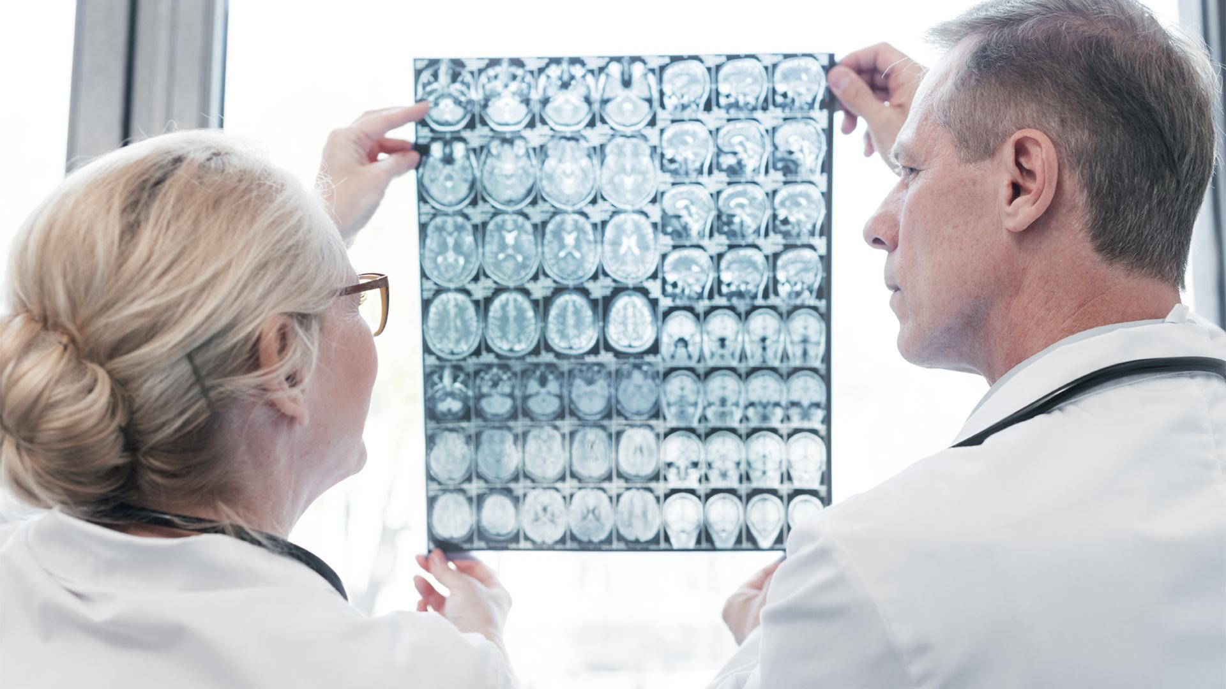
THANK YOU…..

